Slide 1
Renaming files and folders based on regular expressions
Notes:
[Mandatory Slide] This would be the introduction slide of the topic that you are covering in this subsection.
When this slide plays, you could talk about the main aim that we’d be covering in this video.

Slide 2
In this Video, we are going to take a look at…
Organizing lots of files based on their names
Copying and moving files with shutil
Code: organize the photos of my last vacation
Notes:
[Mandatory Slide]
Before the start of the video, we’d like to highlight what are important topics or pointers that we’d be covering in this video. This slide would immediately follow the intro/name slide. This would just be say 2-3 points for the viewers to know what they are getting into.

Slide 3


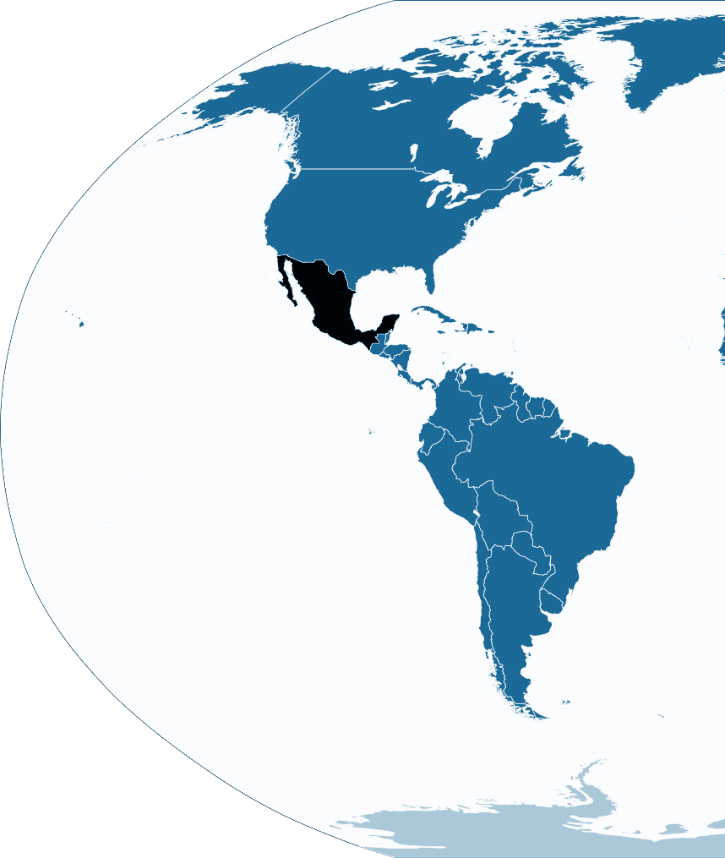
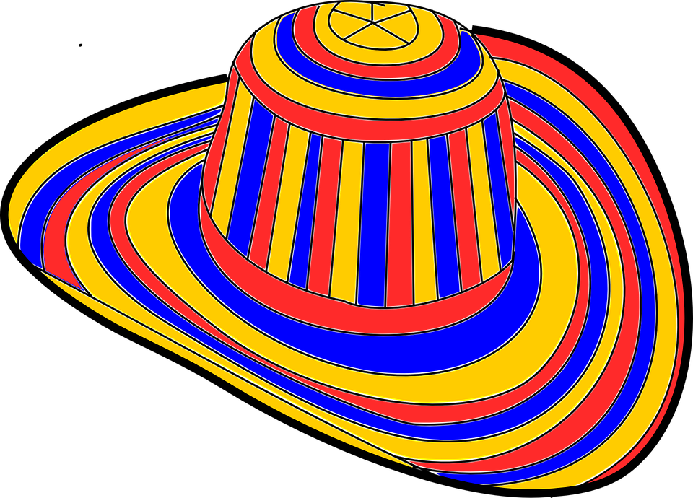


Organizing lots of files based on their names
You just got back from Mexico: your camera is loaded with marvellous photos! Now you need to rename photos so you can easily show them to your friends.
But you notice that the photos:
are hundreds
are stored in multiple folders
are named with date-like patterns (eg. IMG_20170801_0915.jpg)
...
How can you organize all of these photos quickly? Python and regexes to the rescue!
Notes:
This slide can also be used to cover topics that can be represented by an image/graph etc. Information which is half image/half information type. Like shown in the example above.

Slide 4
Copying and moving files with shutil
Shutil helps to copy single files ...
shutil.copy(‘/foo/from.txt’, ‘/bar/to.txt’)
… or entire folder trees
shutil.copytree(‘src’, '/dir/target’)
Also you can move/rename folders and files
shutil.move(‘original.txt’, ‘renamed.txt’)
Notes:
[Mandatory Slide]
Before the start of the video, we’d like to highlight what are important topics or pointers that we’d be covering in this video. This slide would immediately follow the intro/name slide. This would just be say 2-3 points for the viewers to know what they are getting into.

Slide 5
Code: organize the photos of my last vacation
Notes:
Something that needs to grab the viewers attention!!

Slide 6
Summary
How to organize lots of files based on their names
How to copy and move files with shutil
Code: organize the photos of my last vacation
Notes:
This slide, like mentioned is to summarize the various videos we have seen in this section. This gives the viewers a sense of achievement that they have covered exactly what they were looking for.

Slide 7
Detecting file modifications using diffs and hashes
Next Video
Notes:
[Mandatory Slide]
Here the name of the next video needs to be mentioned. The narration as you guessed it would be just letting the viewer know exactly where we are at and what we’d be taking over next! ☺

